Slide 1

DR. N.G.P. INSTITUTE OF TECHNOLOGY
(An Autonomous Institution)
Approved by AICTE, New Delhi & Affiliated to Anna University, Chennai Recognized by UGC & Accredited by NAAC with A+ Grade and NBA (BME, CSE, ECE, EEE and Mechanical)
DEPARTMENT OF ELECTRONICS AND COMMUNICATION ENGINEERING
ACADEMIC YEAR 2023 - 24 [EVEN SEM]
Track Rover
FACULTY GUIDED BY :
DR.R.PADMAVATHY
(ASSISTANT PROFESSOR)
SUBMITTED BY :
BALUSAMY V (710722106019)
BHAVADHARINI M (710722106020)
DHANUSRI M (710722106028)
HARINAA D (710722106046)

Slide 2
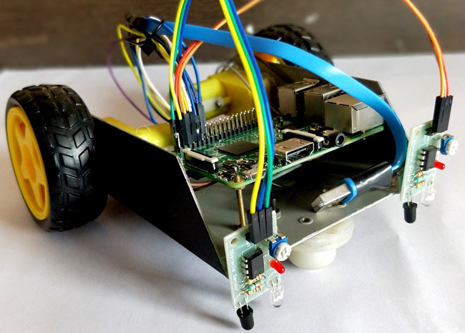
AGENDA
Introduction.
Base Paper Explanation.
Literature Survey.
Problem Identification.
Objective.
Proposed Work.
Block Diagram.
Circuit Diagram.
Hardware Description.
Conclusion.
References.

Slide 3
INTRODUCTION
Line Follower Robot is capable of following a line, just by using pair of sensor and motors.
Line-sensing robots (sometimes called line-following robots) move autonomously by following a line, typically one drawn on the ground underneath the robot.
In early robotics, line following was a way of allowing robots to move autonomously.
The primary goal is for the robot to follow a line accurately and reach its destination without deviating from the path.

Slide 4
BASE PAPER EXPLANATION
Objective and Functionality:The robot follows a path using infrared sensors and avoids obstacles with ultrasonic sensors, rerouting when necessary and returning to the path once clear.
Emergency Indication:If the robot gets stuck, deviates, or stops, it uses a GSM module to call a saved number for emergency notification.
Experimental Calibration:The system was tested for obstacle bypass time, showing a 10-second increase for every 5 cm of obstacle length at a constant speed.
Optimal Speed and Sensor Limitations:The optimal speed for obstacle avoidance is 150 mm/s; exceeding this speed results in inadequate line sensor response, causing increased path tracking time.
Source Paper-2019 “Implementation of an Emergency Indicating Line Follower and Obstacle Avoiding Robot”. (IEEE), pp. 479-482, doi: 10.1109/SSD.2019.88932 41

Slide 5
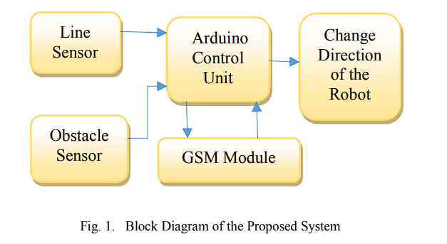
BLOCK DIAGRAM (BASE PAPER)

Slide 6
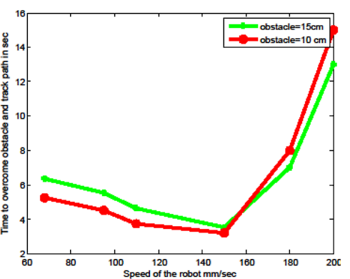
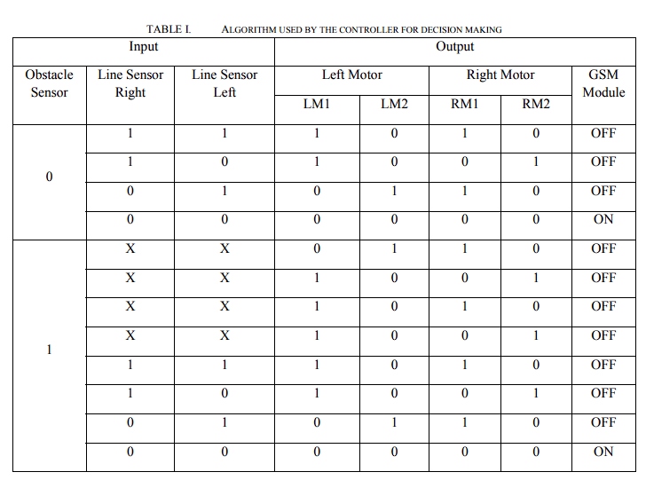

BASE PAPER RESULT

Slide 7
LITERATURE SURVEY
S.NO | TITLE | TECHNOLOGY | JOURNAL | YEAR | INFERENCE
1. | “Development of a Line Follower Robot for Robotic Competition Purposes”. | “Microcontroller (Atmega 328P) | Springer | 2018 | The LFR robot demonstrated high-speed path following with minimal error using a PD controller, but requires further enhancements for handling complex dynamics
2. | “Leader–Follower Navigation in Obstacle Environments While Preserving Connectivity Without Data Transmission” | Track Rover | IEEE Transactions | 2018 | The obstacle environments needs refinement to avoid getting stuck in narrow paths and to regroup more swiftly in open spaces.
3. | “Implementation of an Emergency Indicating Line Follower and Obstacle Avoiding Robot” | Emergency Indicating and Obstacle Avoiding | IEEE | 2019 | Optimal robot speed of 150 mm/s improves obstacle bypass efficiency, but higher speeds reduce line sensor accuracy, increasing path tracking time.

Slide 8
PROBLEM IDENTIFICATION
Inaccurate motor control can cause the robot to overshoot or deviate from the line, leading to instability or erratic behavior.
Weaknesses in the robot's chassis, wheel alignment, or wheel traction can hinder its ability to maneuver smoothly or maintain traction on the surface.
Sensors ( ie, IR sensor ) may have face issues due to bright conditions that damage the sensors.
Sometimes it can’t identify the right path and may be misdirected due to some errors.

Slide 9
OBJECTIVE
To overcome these obstacles,Implement robust motor control algorithms to ensure precise movement and trajectory following, minimizing overshoot and erratic behavior
Improve the chassis design, optimize wheel alignment, and enhance wheel traction for smoother maneuvering and improved surface stability, thereby enhancing overall robot control and stability.

Slide 10
PROPOSED WORK
Our line follower robot utilizes an ESP32 microcontroller board coupled with two IR sensors and an L298N motor driver.
The IR sensors detect the black line on a contrasting surface, guiding the robot's movement.
The L298N motor driver controls two DC motors, enabling precise adjustments to maintain alignment with the track.
This setup ensures accurate and efficient navigation along predefined paths, making it suitable for educational and hobbyist projects in robotics.

Slide 11
BLOCK DIAGRAM
Power Supply
Esp32
L298N
Motor Driver
Left Motor
Right Motor
Left IR Sensor
Right IR Sensor

Slide 12
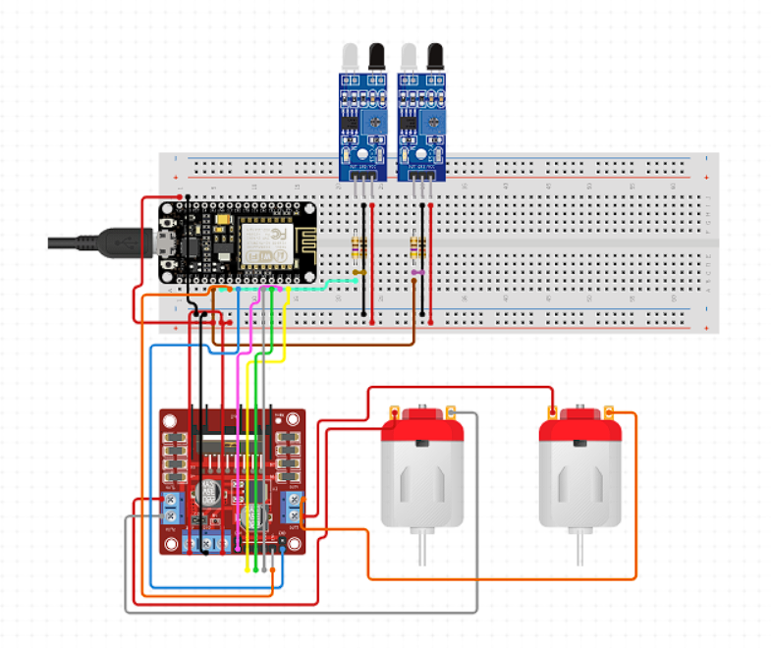
CIRCUIT DIAGRAM
Fig. Circuit diagram of Line Follower using ESP32

Slide 13
HARDWARE COMPONENTS
ESP32
Motor driver (e.g., L298N) to control the motors
Infrared (IR) sensors
Chassis
DC motors

Slide 14
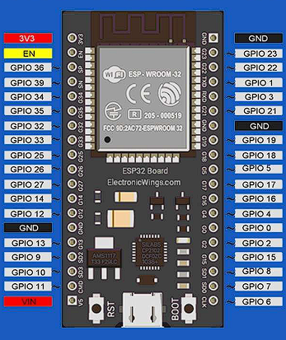
HARDWARE DESCRIPTION
ESP32 :
The ESP32 is a powerful microcontroller module developed by Espressif Systems, featuring dual-core processors running at up to 240 MHz.
It includes built-in Wi-Fi and Bluetooth connectivity, making it suitable for IoT applications.
With sample memory and efficient power management, the ESP32 is widely used in projects requiring robust wireless communication and advanced processing capabilities.

Slide 15
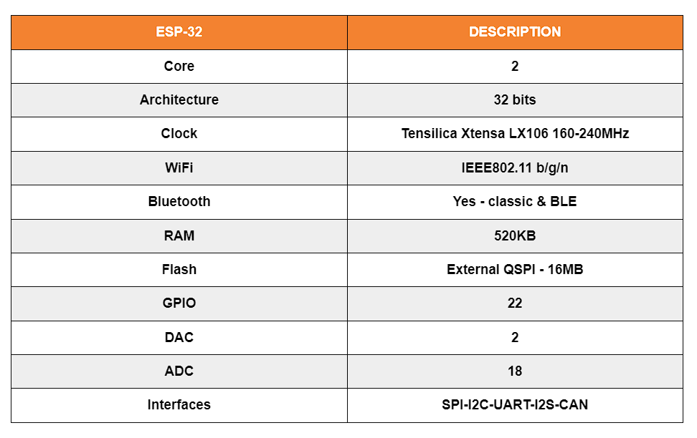

Slide 16
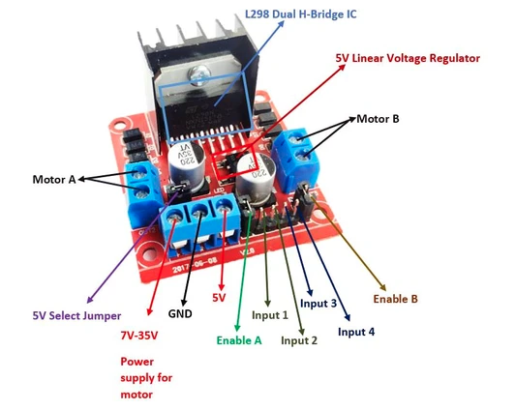
HARDWARE DESCRIPTION
L298N MOTOR DRIVER :
The L298N is a dual H-Bridge motor driver which allows speed and direction control of two DC motors at the same time.
The module can drive DC motors that have voltages between 5 and 35V, with a peak current up to 2A.

Slide 17
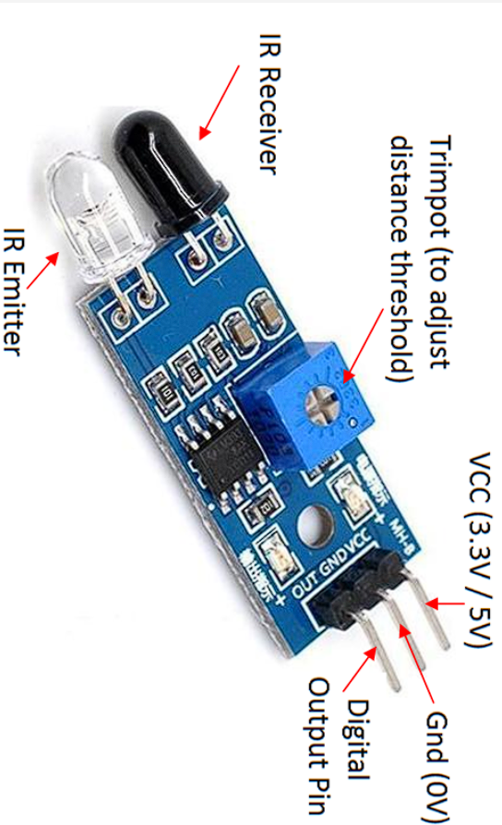
HARDWARE DESCRIPTION
IR SENSOR:
A line follower consists of an infrared light sensor and an infrared LED.
It works by illuminating a surface with infrared light; the sensor then picks up the reflected infrared radiation and, based on its intensity, determines the reflectivity of the surface in question.

Slide 18
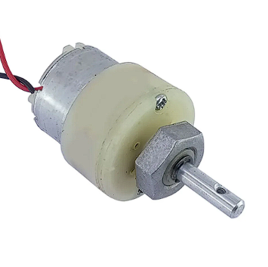
HARDWARE DESCRIPTION
DC Motor:
This 12V DC Motor – 200RPM can be used in all-terrain robots and a variety of robotic applications.
These motors have a 3 mm threaded drill hole in the middle of the shaft thus making it simple to connect it to the wheels or any other mechanical assembly.

Slide 19
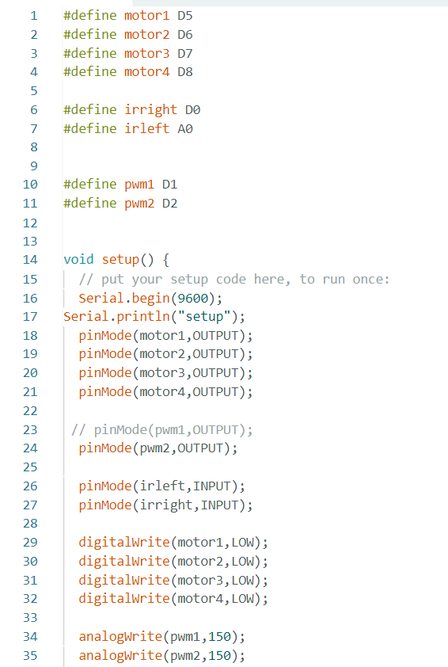
PROGRAM

Slide 20
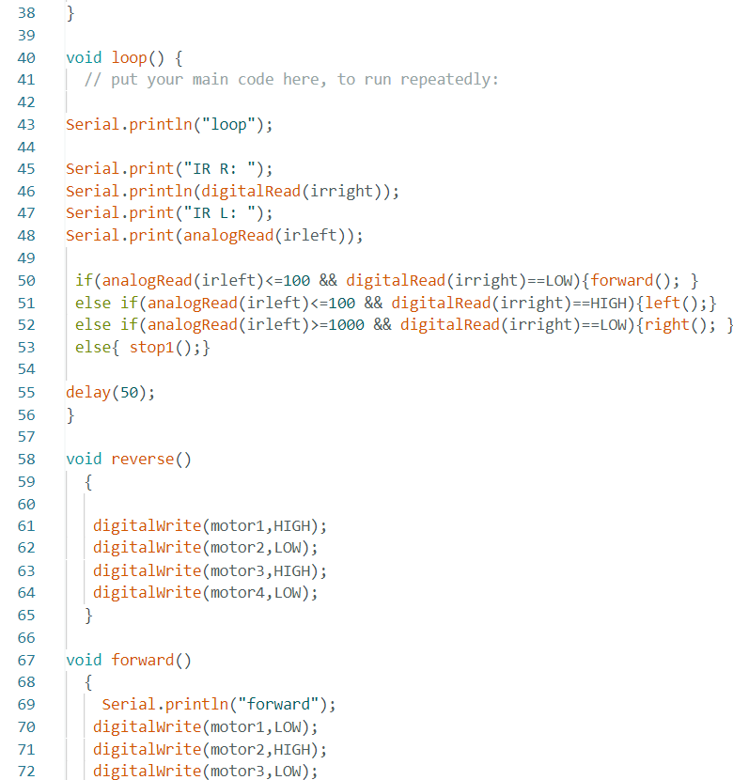
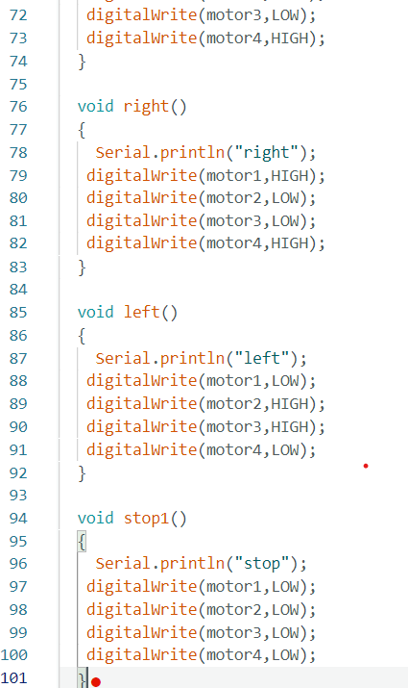

Slide 21
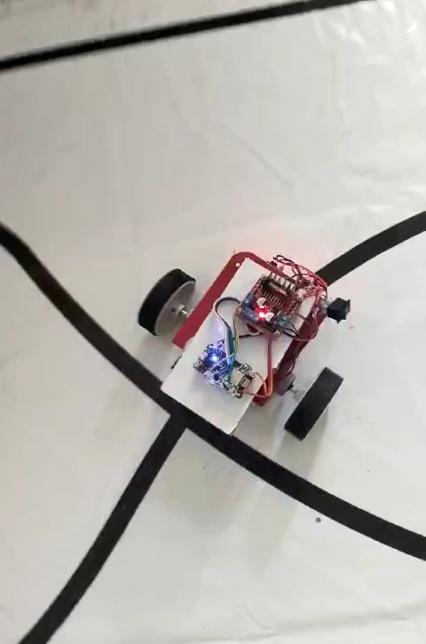
OUTPUT

Slide 22
RESULT AND INFERENCE
The line follower robot utilizing an ESP32 microcontroller successfully navigated a predefined path marked by a contrasting line, consistently adjusting its movement to stay on track.
The infrared sensors accurately detected the line, and the ESP32 effectively processed this data to control the motors, ensuring smooth and responsive navigation even around curves and sharp turns.
This indicates that the ESP32, combined with well-calibrated sensors and efficient motor control algorithms, can reliably manage real-time adjustments for precise line following, highlighting its potential for applications in automated systems and robotics.

Slide 23
CONCLUSION
In conclusion, the line follower robot powered by the ESP32 microcontroller proved to be a reliable and efficient system for autonomous navigation along a predefined path.
The combination of accurate infrared sensors, responsive motor control, and the ESP32's processing capabilities allowed the robot to follow the line smoothly and handle various track conditions effectively.
This demonstrates the ESP32's suitability for real-time control applications in robotics, showcasing its potential for use in automated systems and industrial automation where precise and autonomous movement is required.

Slide 24
REFERENCE
[1] Harold Murcia et al,” Development of a Line Follower Robot for Robotic Competition Purposes”.Springer – Robotic Competition Purposes, Vol 10 Pages – 464-474 (2018).
[2] Daito Sakai et al, “Leader–Follower Navigation in Obstacle Environments While Preserving Connectivity Without Data Transmission” IEEE (2018).
[3] Prajoona Valsalan et al,“Implementation of an Emergency Indicating Line Follower and Obstacle Avoiding Robot” IEEE (2019).
[4] Satyam Tayal et al, “Line Follower Robot: Design and Hardware Application” ICRITO (2020).
[5] Sepehr Saadatrnand et al, “Autonomous Control of a Line Follower Robot Using a Q-Leaming Controller” IEEE (2020).

Slide 25
THANK YOU

